Slide 1
DIGITAL EMPOWERMENT
HEINEKEN VIETNAM

Slide 2
Agenda
Team introduction
Input/Output introduction
Solution pipeline
Models’ information and evaluation
Demo
Development path
Q&A

Slide 3
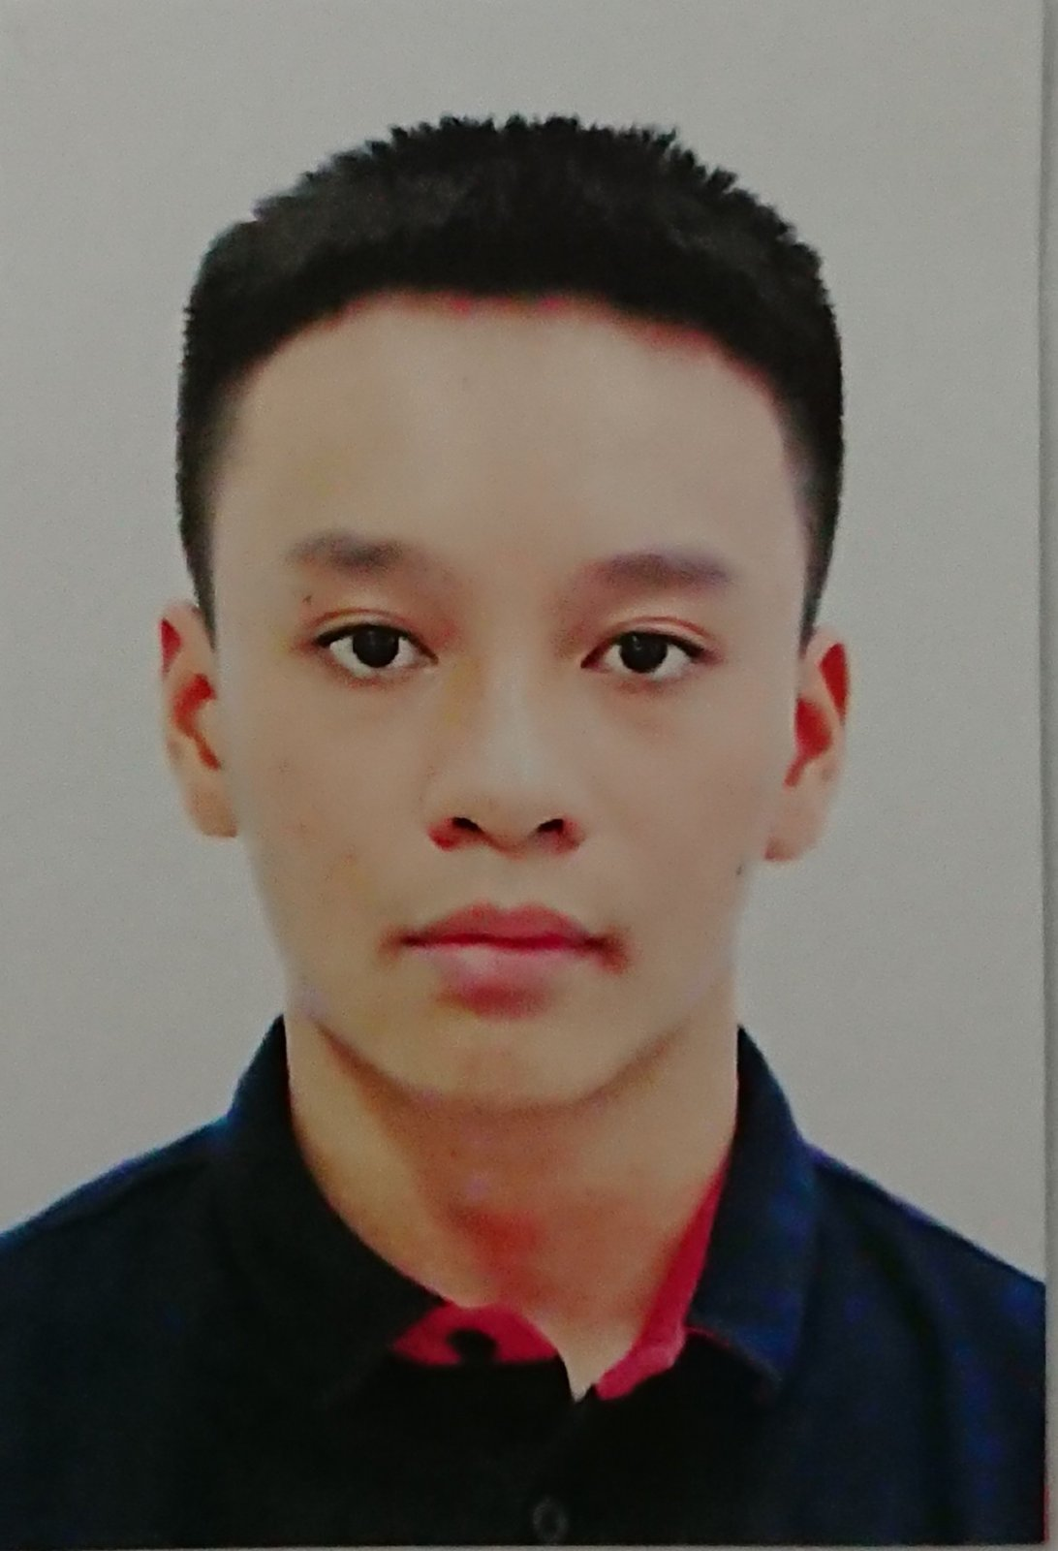


OUR TEAM
Full name: Nguyen Nguyen Khoi
Major: Computer Science
Full name: Bui Quoc Thinh
Major: Computer Science
Full name: Do Minh Khoi
Major: Computer Science
University of Information Technology

Slide 4
I.
INPUT/OUTPUT INTRODUCTION

Slide 5
Input - output
Input: an image
Output:
Number of people, their emotions and the dominant emotion (problem no. 3)
Locate promotion girls, number of them, check whether it>2 (problem no. 4)
Locate printed advertisings: ice boxes, ice buckets, bottles, cans, refrigerators, billboards, standees, parasols (problem no. 2)

Slide 6
Input - output
On problem no. 4:
All detected promotion girls are counted, regardless of their companies
Female and standing individuals are taken into consideration

Slide 7
Input - output
On problem no. 2:
Printed products that are of these companies below are chosen
Heineken, Tiger, Bia Viet, Larue, Bivina, Edelweiss, Strongbow

Slide 8
II. Solution pipeline

Slide 9
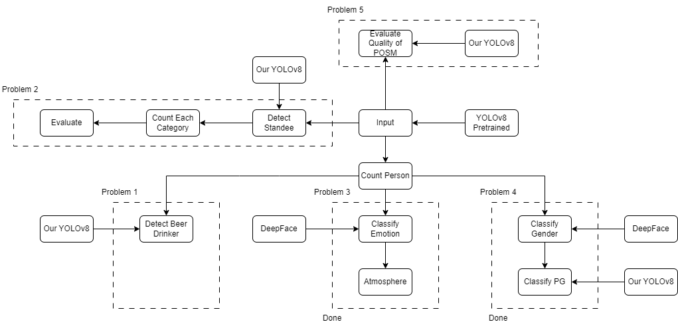
SOLUTION PIPELINE

Slide 10
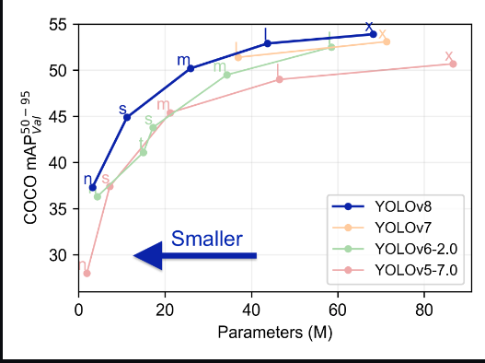
MODELS’ INFORMATION
Our solution is entirely YOLOv8-based

Slide 11
MODELS’ INFORMATION
For face detection in problem no. 3, we utilize a pretrained YOLOv8m on WIDERFace, which is available in DeepFace framework

Slide 12
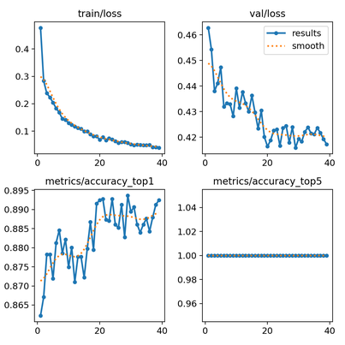
MODELS’ INFORMATION
For detecting promotion girls, we fine-tune YOLOv8m on … to check whether a person is sitting or standing

Slide 13
DEMO

Slide 14
DEMO
…

Slide 15
Development path

Slide 16
Development path
Spend more time labelling dataset provided by the organizers
Find a method of effective and automative data labelling instead of doing it manually
Find a method capable of detecting small promotional materials (printed advertisings)

Slide 17
Q&A

